Slide 1
Once-Weekly Semaglutide in Adults with Overweight or Obesity March18 , 2021, NEJM
KPC Medical College & Hospital
Dr Suman Sarkar
PG Resident
Department of Medicine
KPC Medical College & Hospital
Kolkata

Slide 2
N Engl J Med 2021;384:989-1002

Slide 3
Index Patient
Miss X, 25 year old college girl
Nondiabetic, Nonhypertensive, euthyroid patient
No history of addiction. Family history DM present (both parents)
Weight of 82kg, BMI 32.
She accompanies her parents to our out patient clinic.

Slide 4
Obesity
Obesity is a complex chronic disease in which abnormal or excess body fat impairs health, increases the risk of long-term medical complications and reduces lifespan.
Obesity can lead to insulin resistance, hypertension and dyslipidaemia
Complications : Type 2 Diabetes Mellitus, Cardiovascular disease, Non-alcoholic fatty liver disease and reduced life expectancy.

Slide 5
Semaglutide
A glucagon-like peptide-1 (GLP-1) analogue.
Approved, at doses up to 1 mg subcutaneously once weekly.
Indications:
Treatment of type 2 diabetes in adults
For reducing the risk of cardiovascular events in Type 2 DM and CVD.

Slide 6
Semaglutide is a human GLP-1 analogue
94% homology to human GLP-1
t_{½} of approximately 1 week
Reduced appetite & cravings, improved control of eating
Reduced
energy intake
EFFECTS
Other metabolic & CV effects
Reduced body weight

Slide 7
Semaglutide 2.4 mg
Semaglutide 2.4mg/week was approved for weight management by the FDA on June 4, 2021
Per the FDA approval, it is indicated “as an adjunct to diet and exercise in adults with obesity (initial BMI > 30 kg/m2) or overweight (initial BMI > 27kg/m2) with at least one weight-related comorbidity”
This approval was based on the phase 3a STEP program, which is the subject of this discussion.

Slide 8
Study Design
A randomized, double-blind, placebo controlled trial
129 sites in 16 countries in Asia, Europe, North America, and South America
Total participants : 1961
Semaglutide (1306) or placebo (655)
Time period : June to November 2018

Slide 9
Objectives
To evaluate the efficacy and safety of Semaglutide administered subcutaneously at a dose of 2.4 mg once weekly in persons with overweight or obesity, with or without weight-related complications

Slide 10
Inclusion Criteria
Adults (18 years of age or older) with one or more self-reported unsuccessful dietary efforts to lose weight.
BMI of ≥ 30 or a BMI of ≥ 27 with one or more treated or untreated weight-related coexisting conditions (Hypertension, dyslipidemia, obstructive sleep apnoea, or cardiovascular disease)

Slide 11
Exclusion Criteria
Diabetes Mellitus with a glycated hemoglobin level of 6.5% or greater
A history of chronic pancreatitis
Acute pancreatitis within 180 days before enrolment
Previous surgical obesity treatment, and use of anti obesity medication within 90 days before enrolment.

Slide 12
Methods
Participants were randomly assigned in a 2:1 ratio, through an interactive Web-based response system.
Semaglutide 2.4 mg s/c once a week for 68 weeks or matching placebo, in addition to lifestyle intervention

Slide 13
Methods - Continued..
This 68-week period was followed by a 7-week period without receipt of Semaglutide or placebo or lifestyle intervention.
Semaglutide, administered with a prefilled pen injector, was initiated at a dose of 0.25 mg once weekly for the first 4 weeks, with the dose increased every 4 weeks to reach the maintenance dose of 2.4 mg weekly by week 16

Slide 14
Methods - Continued..
Lower maintenance doses were permitted if participants had unacceptable side effects with the 2.4 mg dose
Participants received individual counselling sessions every 4 weeks to help them adhere to a reduced-calorie diet and increased physical activity (with 150 minutes per week of physical activity, such as walking, encouraged).

Slide 15
Methods - Continued..
Both diet and activity were recorded daily.
In a diary
A smartphone application
Other tools
Participants discontinuing treatment prematurely remained in the trial

Slide 16
Primary End Points
Percentage change in body weight from baseline to week 68.
Achievement of a reduction in body weight of 5% or more from baseline to week 68

Slide 17
Secondary End Points
Achievement of a reduction in body weight of 10% or more and 15% or more by week 68
Change from baseline to week 68 in waist circumference, systolic blood pressure and physical function score

Slide 18
Demographic and Clinical Characteristics of the Participants at Baseline.

Slide 19
Demographic and Clinical Characteristics of the Participants at Baseline.

Slide 20
Demographic and Clinical Characteristics of the Participants at Baseline.

Slide 21
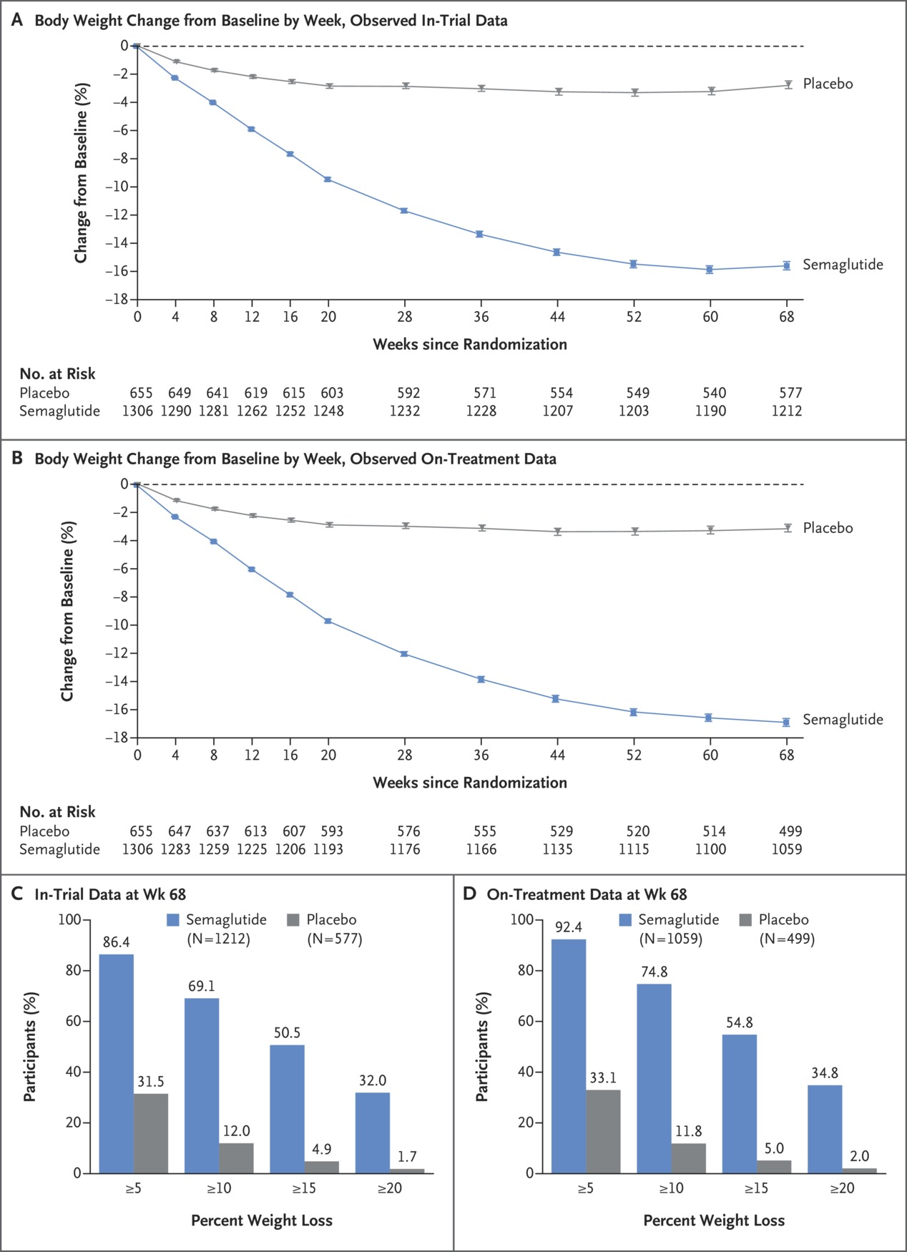
In-Trial Data
On-Treatment Data

Slide 23
Adverse Events

Slide 24
Adverse Events

Slide 25
Results
Overall:
94.3% completed the trial
91.2% had a bodyweight assessment
81.1% adhered to treatment
Rescue interventions :
7 in Semaglutide group
13 in placebo group

Slide 26
Results - Continued..
Change in Body Weight observed from week 4 onwards. It reaching a nadir at week 60
Mean weight change at week 68.
14.9% with 2.4mg Semaglutide
2.4% with placebo
Treatment difference: 12.4% (P<0.001)

Slide 27
Results - Continued..
Semaglutide was more likely to cause 5%, 10%, 15% and 20% weight loss at week 68 than placebo.
Semaglutide was associated with greater reductions in
Waist circumference
SBP and DBP at week 68

Slide 28
Results - Continued..
Semaglutide group had greater changes in :
Glycated hemoglobin
Fasting plasma glucose
C-reactive protein
Fasting lipid levels.
Prediabetics reverting to normoglycemia
84.1% in Semaglutide group
47.8% in placebo group

Slide 29
Results - Continued..
SF-36 physical functioning scores (with possible norm-based scores ranging from 19.03 to 57.60) improved significantly more with Semaglutide than with placebo at week 68 (P<0.001)
IWQOL-Lite-CT physical function scores improved significantly more with Semaglutide than with placebo at week 68 (P<0.001).

Slide 30
Results - Continued..
In the DXA subpopulation (140 participants), total fat mass and regional visceral fat mass were reduced from baseline with Semaglutide.
Although total lean body mass decreased in absolute terms (kg), the proportion of lean body mass relative to total body mass increased with Semaglutide

Slide 31
Conclusion
In overweight or obesity:
Semaglutide 2.4 mg s/c weekly was associated with sustained, clinically relevant reduction in body weight

Slide 32
Strength of the study
Large sample size
High rates of adherence to the treatment regimen
Completion of the trial

Slide 33
Limitation of the study
The preponderance of women and white participants
The relatively short duration of the trial
The exclusion of persons with type 2 diabetes

Slide 34
Limitation of the study - Continued..
Participants who were enrolled may represent a subgroup with greater commitment to weight-loss.
The DXA data report were performed in only a subpopulation of participants

